Slide 1
Phasor Data Concentrator (PDC)
A phasor data concentrator collects phasor data from multiple PMUs or PDCs
It alligns the data using time-tag to create a time-synchronized dataset
It passes this data to other information system
It also performs data quality checks

Slide 2
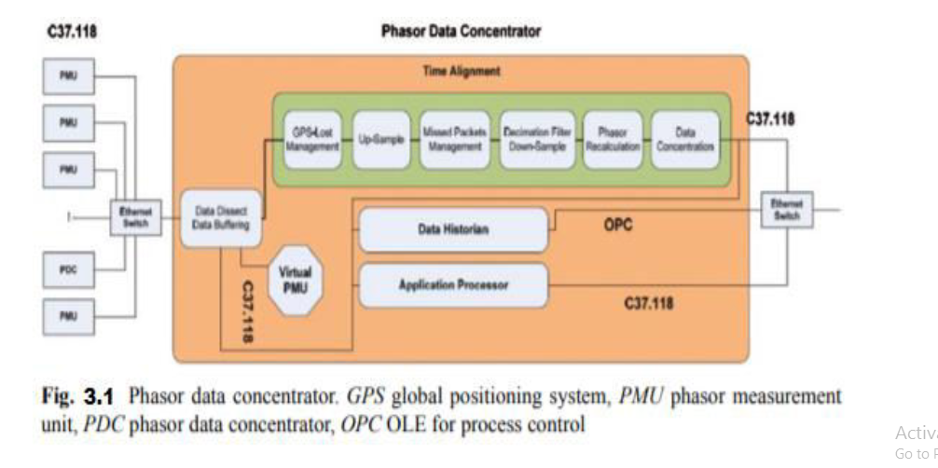

Slide 3
PDC store phasor data so it can be used in applications with slower sample rates such as Supervisory control and data acquisition (SCADA)
The real-time data broadcasting capability enables us to make us of aligned time data
Each measurement carries a precise time stamp take from GPS module so that the entire system can be analyzed at any moment

Slide 4
PDC levels
The function of PDC can vary depending on its role between PMUs, There are 3 levels of PDC as shown below
Local PDC
Corporate PDC
Super PDC

Slide 5
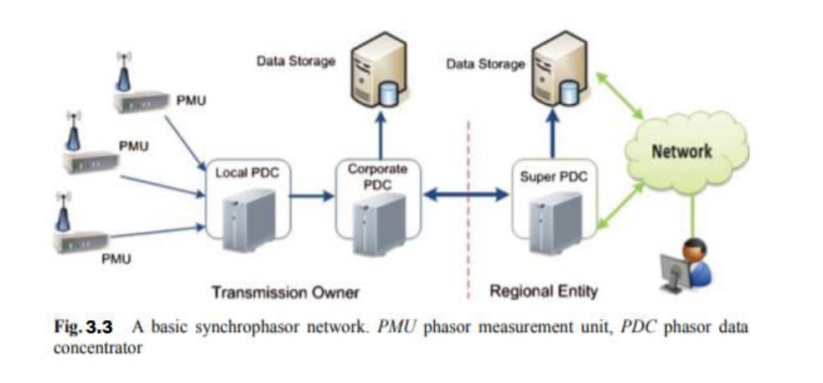
PDC Levels

Slide 6
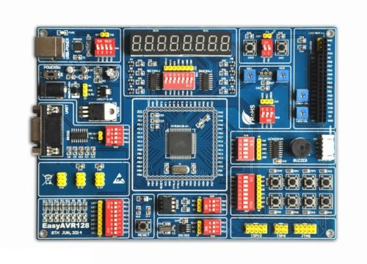
Application
In our project we used AT mega 128 microcontroller as a PDC
Its illustrated as AVR(3) which stores phasor data from the PMUs [AVR(1) and AVR(2)] and transmit them to the HMI (Human machine interface) smart screen to view the current and voltage synchronized measurements

